Slide 1
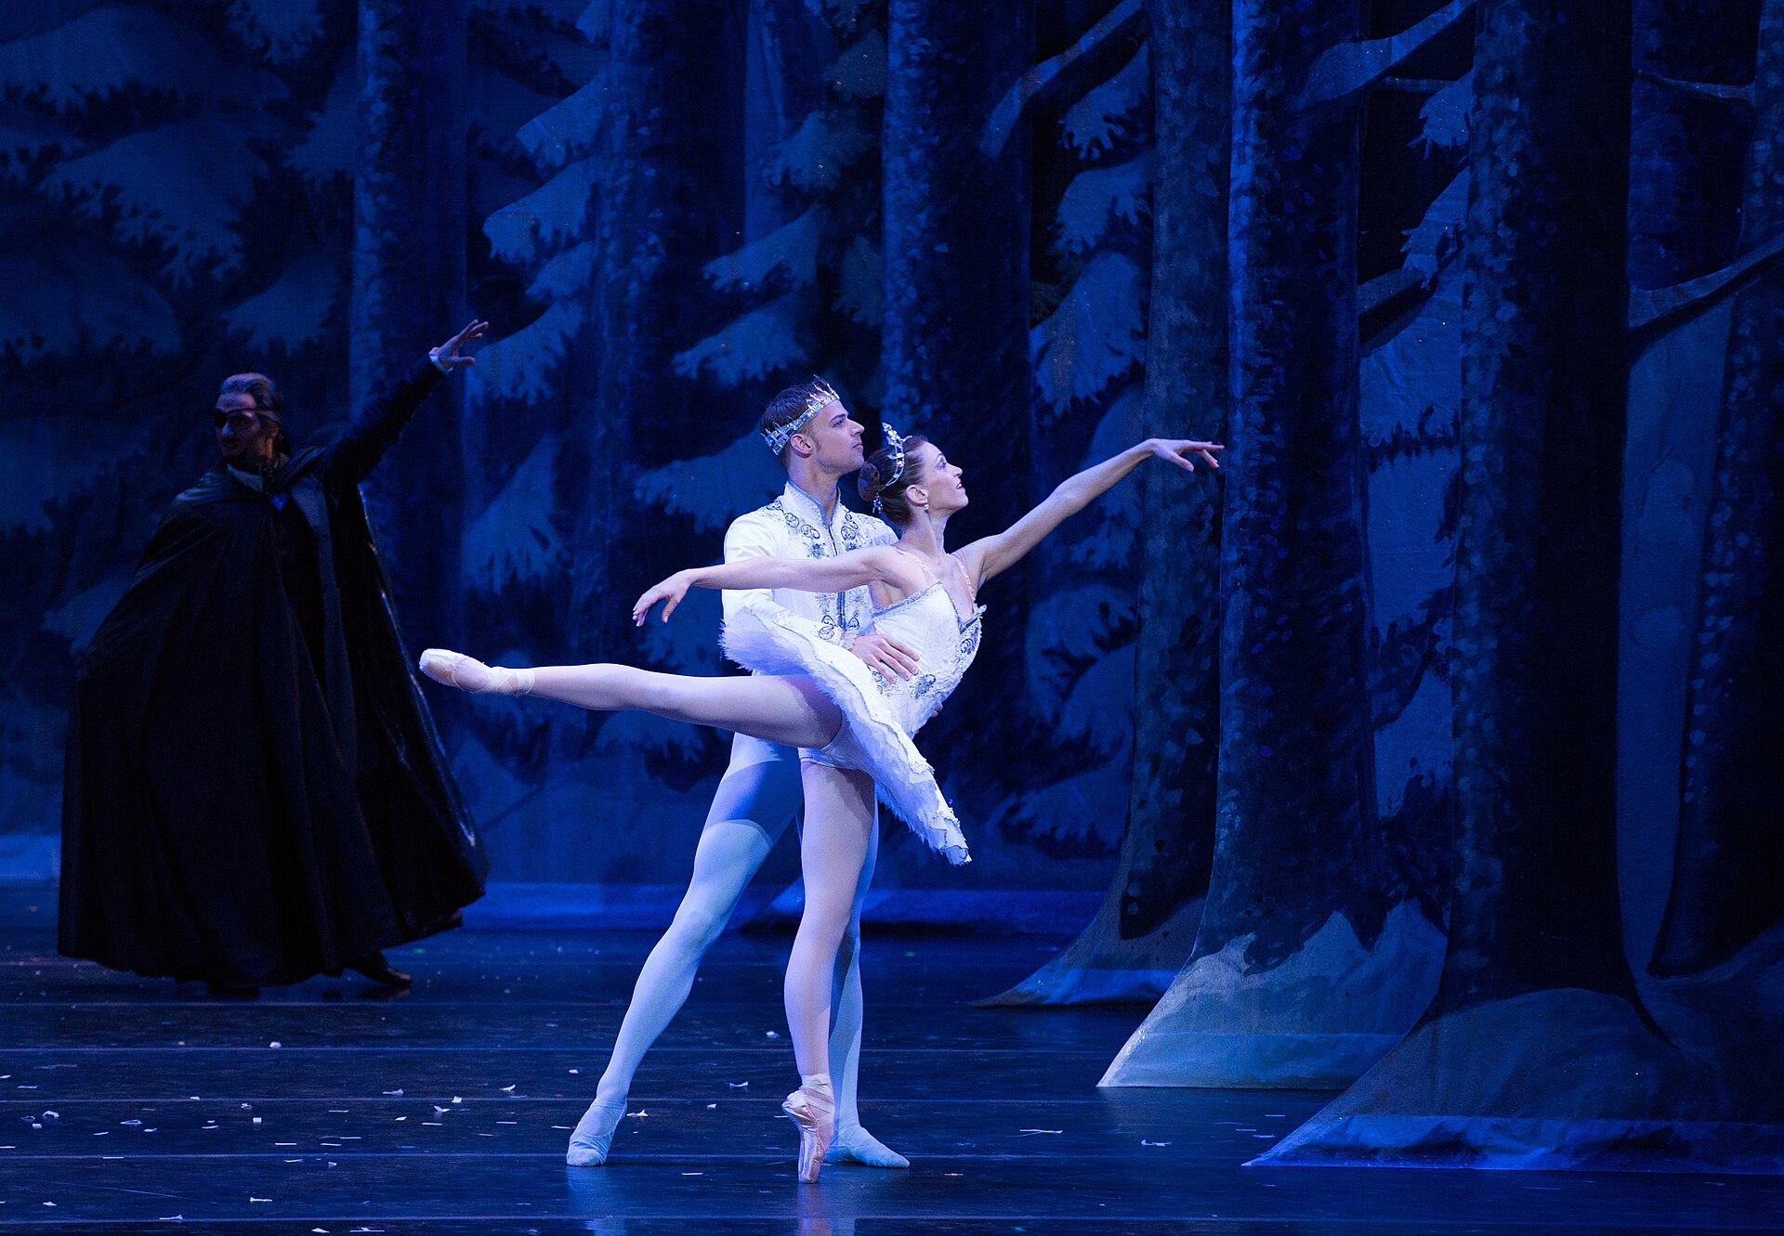
[STUDIO NAME]
THE
NUTCRACKER
[DATES + TIMES]
[VENUE], [TOWN]
Tickets through the link in bio
PHOTO EXAMPLE / REPLACE BEFORE POSTING
Notes:
BWC Nutcracker Feed template 1. Full-photo, large-white-type revision inspired by the user's Barre Trash direction. Headline: Arial Black, body: Arial; an editable approximation, not a verified Barre Trash font match. All wording remains editable. Replace the picture through the Selection Pane (the dark contrast overlay and text sit above it). Replace brackets and the Clara description when relevant. Keep faces and the main dancer's movement clear. Remove the PHOTO EXAMPLE label only after replacing the reference photo. Export as PNG. Stories need a real ticket-link sticker added in Instagram. Reference photo: KCB Company Dancers Angelina Sansone and Thom Panto
Photography by Rosalie O'Connor; KCBalletMedia; 2015-12-02 19:53; https://commons.wikimedia.org/wiki/File:KC_Ballet_Kansas_City_Ballet_(23151652839).jpg; https://creativecommons.org/licenses/by/2.0. Cropped and resized. Not BWC client work or the fictional studio's production. Matching copy: 1.

Slide 2
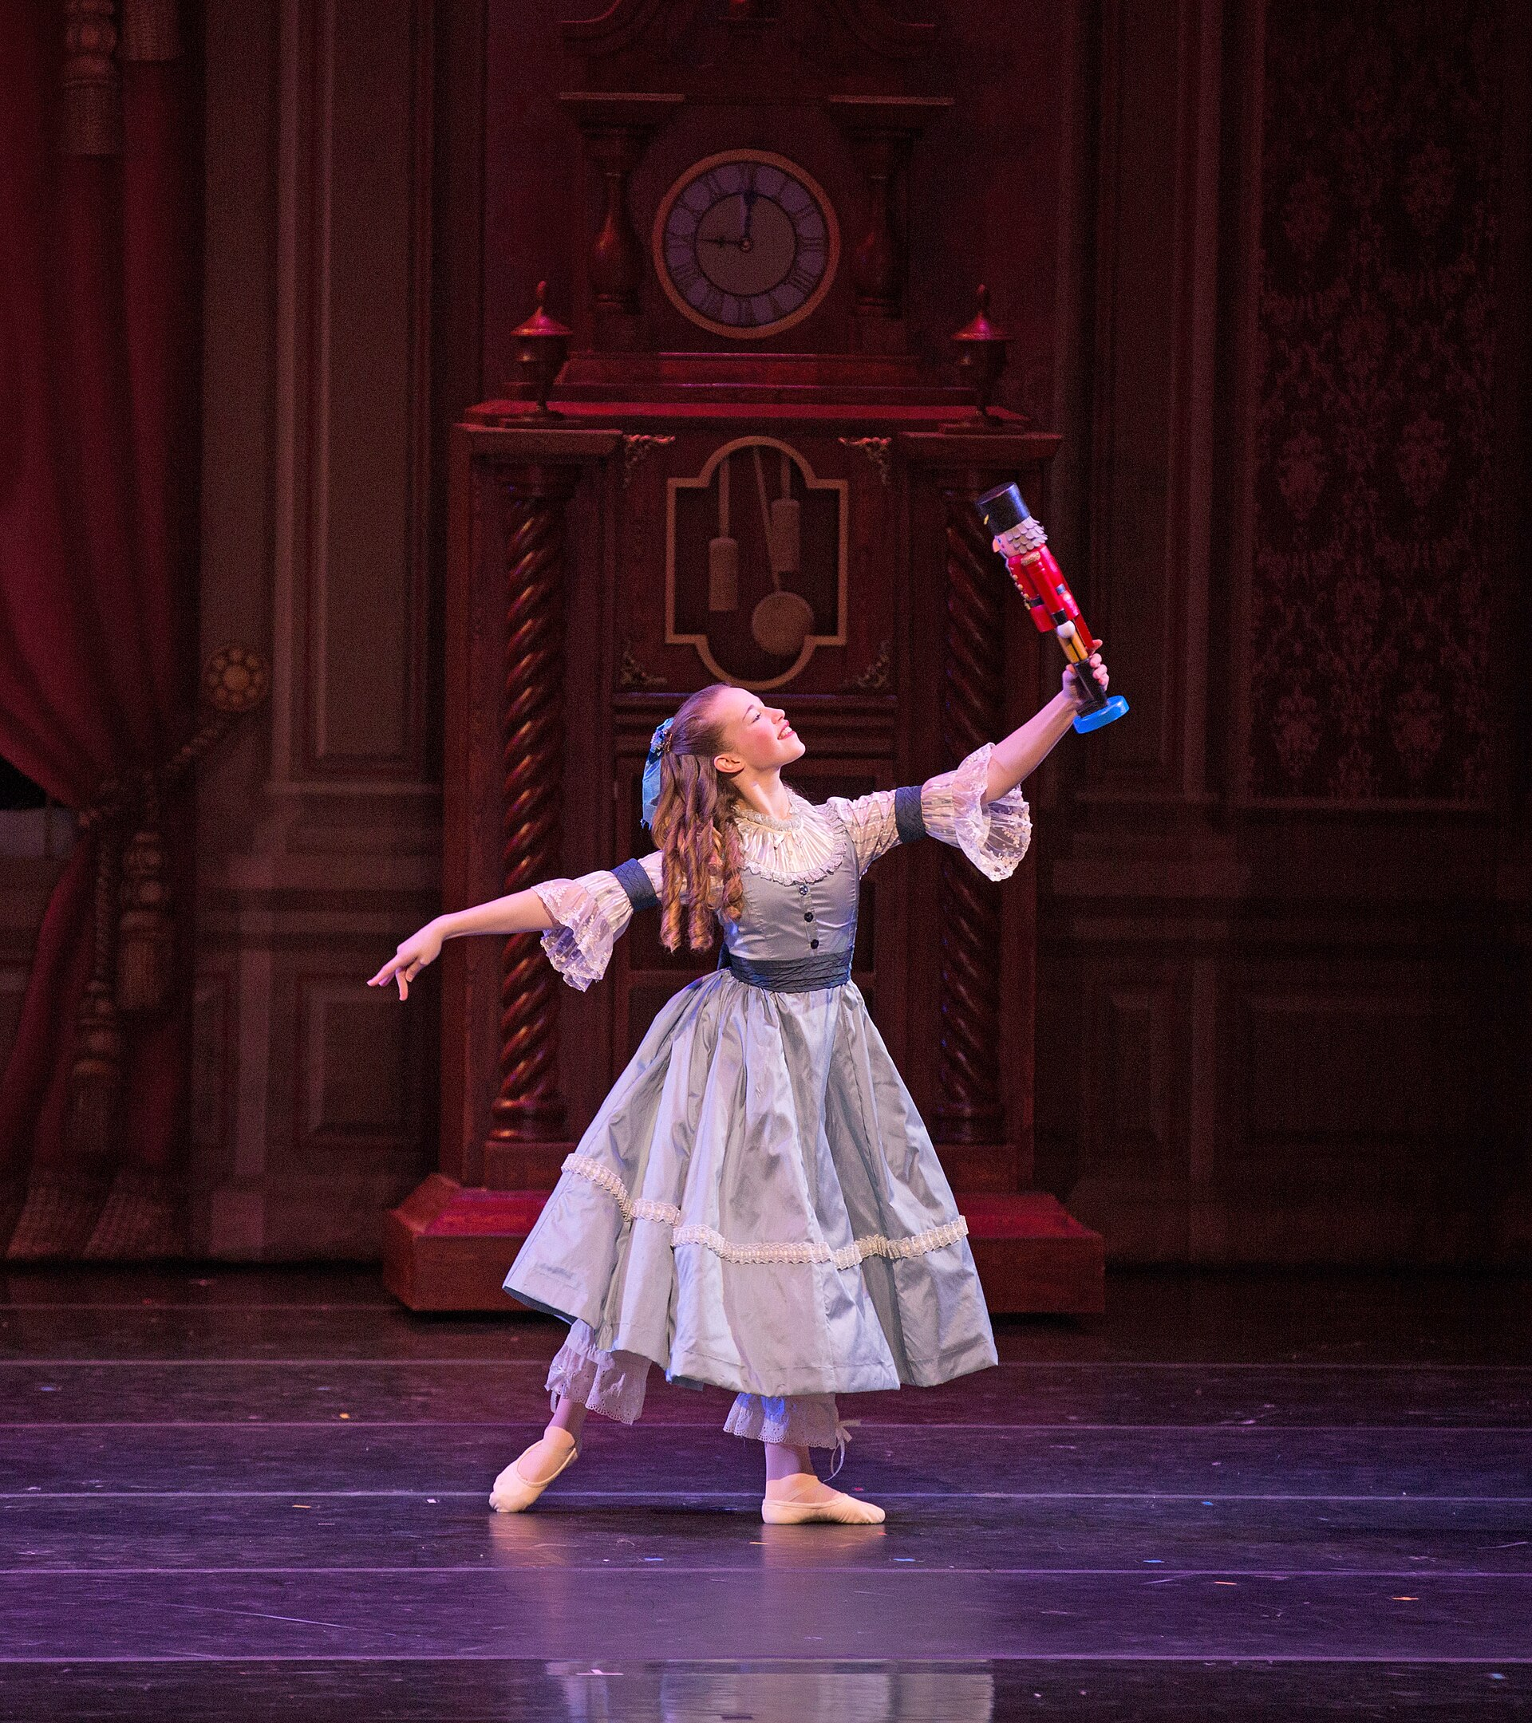
[STUDIO NAME]
MEET
[ROLE]
A little courage. A whole new world.
See this cast on [CAST DATE]
Tickets through the link in bio
PHOTO EXAMPLE / REPLACE BEFORE POSTING
Notes:
BWC Nutcracker Feed template 2. Full-photo, large-white-type revision inspired by the user's Barre Trash direction. Headline: Arial Black, body: Arial; an editable approximation, not a verified Barre Trash font match. All wording remains editable. Replace the picture through the Selection Pane (the dark contrast overlay and text sit above it). Replace brackets and the Clara description when relevant. Keep faces and the main dancer's movement clear. Remove the PHOTO EXAMPLE label only after replacing the reference photo. Export as PNG. Stories need a real ticket-link sticker added in Instagram. Reference photo: KCB School Student Sarah Wallis
Photography by Rosalie O'Connor; KCBalletMedia; 2015-12-02 19:35; https://commons.wikimedia.org/wiki/File:KC_Ballet_Kansas_City_Ballet_(22892157113).jpg; https://creativecommons.org/licenses/by/2.0. Cropped and resized. Not BWC client work or the fictional studio's production. Matching copy: 4.

Slide 3
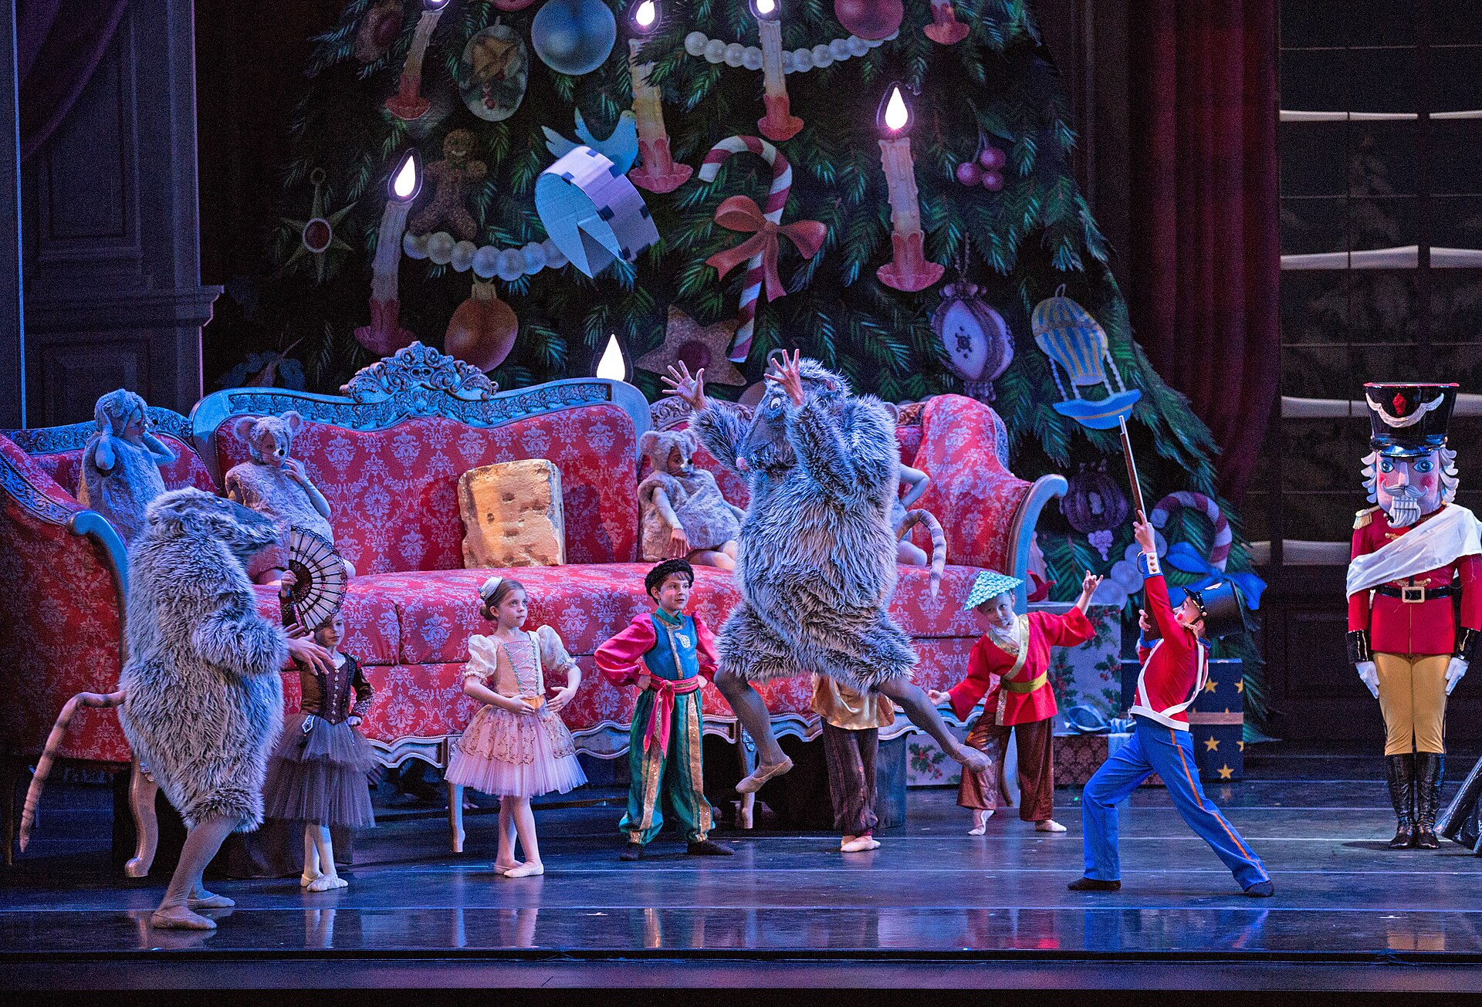
[STUDIO NAME]
FIRST
NUTCRACKER?
RUNNING TIME
[RUNTIME]
AGE GUIDANCE
[AGE POLICY]
Visit details and tickets in bio
PHOTO EXAMPLE / REPLACE BEFORE POSTING
Notes:
BWC Nutcracker Feed template 3. Full-photo, large-white-type revision inspired by the user's Barre Trash direction. Headline: Arial Black, body: Arial; an editable approximation, not a verified Barre Trash font match. All wording remains editable. Replace the picture through the Selection Pane (the dark contrast overlay and text sit above it). Replace brackets and the Clara description when relevant. Keep faces and the main dancer's movement clear. Remove the PHOTO EXAMPLE label only after replacing the reference photo. Export as PNG. Stories need a real ticket-link sticker added in Instagram. Reference photo: KCB Dancers and KCB School Students
Photography by Rosalie O'Connor; KCBalletMedia; 2015-12-02 19:47; https://commons.wikimedia.org/wiki/File:KC_Ballet_Kansas_City_Ballet_(22891116274).jpg; https://creativecommons.org/licenses/by/2.0. Cropped and resized. Not BWC client work or the fictional studio's production. Matching copy: 3.

Slide 4
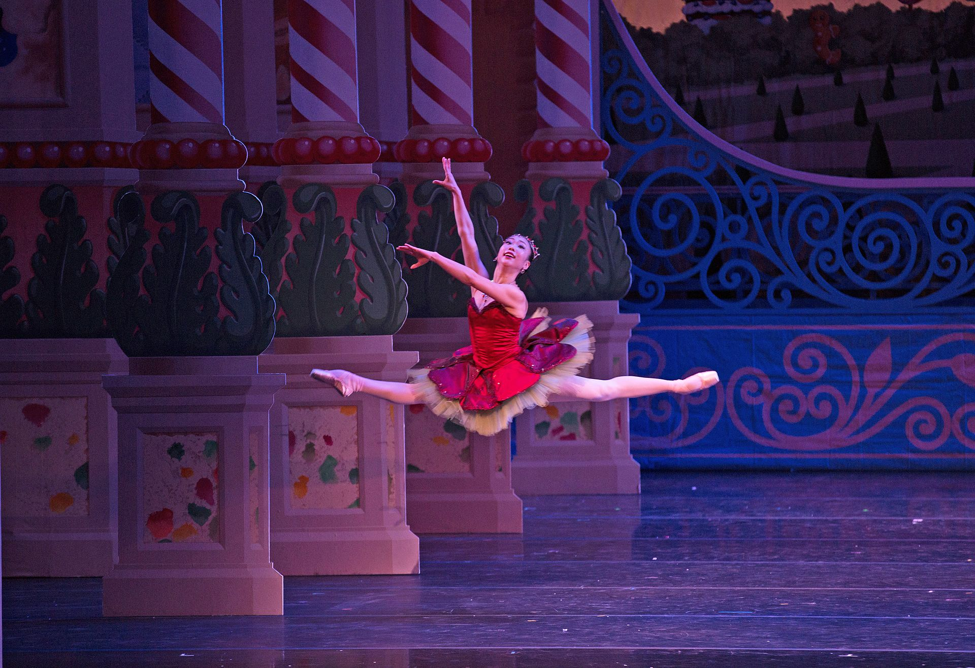
[STUDIO NAME]
YOUR HOLIDAY
OUTING
The Nutcracker in [TOWN]
[DATES + TIMES]
[VENUE], [TOWN]
Tickets through the link in bio
PHOTO EXAMPLE / REPLACE BEFORE POSTING
Notes:
BWC Nutcracker Feed template 4. Full-photo, large-white-type revision inspired by the user's Barre Trash direction. Headline: Arial Black, body: Arial; an editable approximation, not a verified Barre Trash font match. All wording remains editable. Replace the picture through the Selection Pane (the dark contrast overlay and text sit above it). Replace brackets and the Clara description when relevant. Keep faces and the main dancer's movement clear. Remove the PHOTO EXAMPLE label only after replacing the reference photo. Export as PNG. Stories need a real ticket-link sticker added in Instagram. Reference photo: KCB Company Dancer Sarah Chun
Photography by Rosalie O'Connor; KCBalletMedia; 2015-12-02 20:57; https://commons.wikimedia.org/wiki/File:KC_Ballet_Kansas_City_Ballet_(23410750652).jpg; https://creativecommons.org/licenses/by/2.0. Cropped and resized. Not BWC client work or the fictional studio's production. Matching copy: 8.

Slide 5
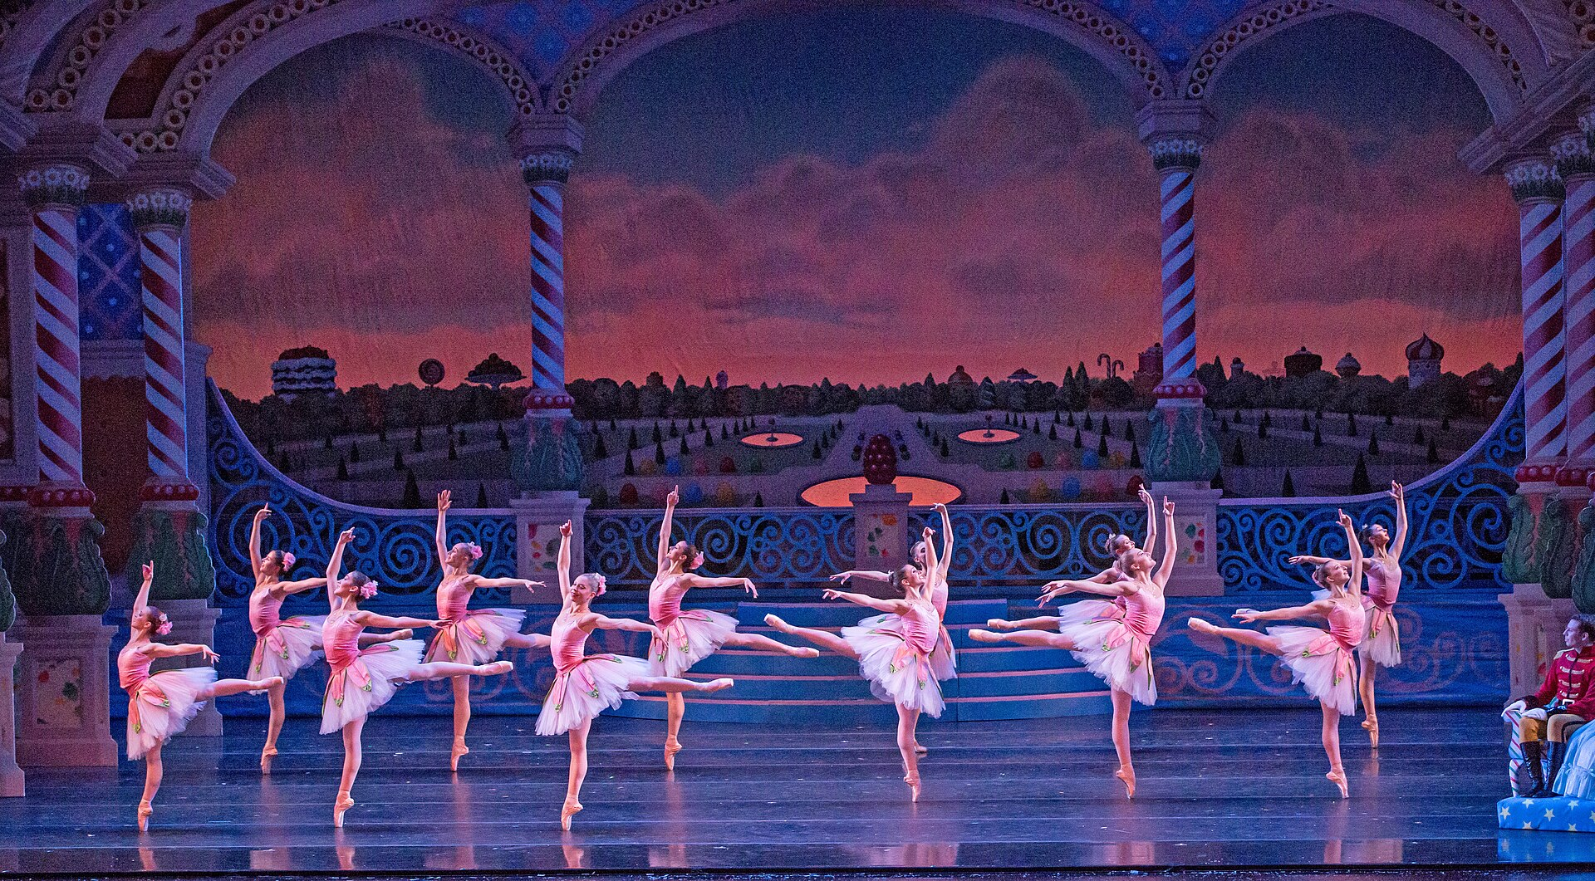
[STUDIO NAME]
7
DAYS TO
CURTAIN
The Nutcracker
[DATES + TIMES]
Tickets through the link in bio
PHOTO EXAMPLE / REPLACE BEFORE POSTING
Notes:
BWC Nutcracker Feed template 5. Full-photo, large-white-type revision inspired by the user's Barre Trash direction. Headline: Arial Black, body: Arial; an editable approximation, not a verified Barre Trash font match. All wording remains editable. Replace the picture through the Selection Pane (the dark contrast overlay and text sit above it). Replace brackets and the Clara description when relevant. Keep faces and the main dancer's movement clear. Remove the PHOTO EXAMPLE label only after replacing the reference photo. Export as PNG. Stories need a real ticket-link sticker added in Instagram. Reference photo: KCB Company Dancers
Photographer: Brett Pruitt & East Market Studios; KCBalletMedia; 2015-12-02 19:57; https://commons.wikimedia.org/wiki/File:KC_Ballet_Kansas_City_Ballet_(23520131175).jpg; https://creativecommons.org/licenses/by/2.0. Cropped and resized. Not BWC client work or the fictional studio's production. Matching copy: 15.

Slide 6
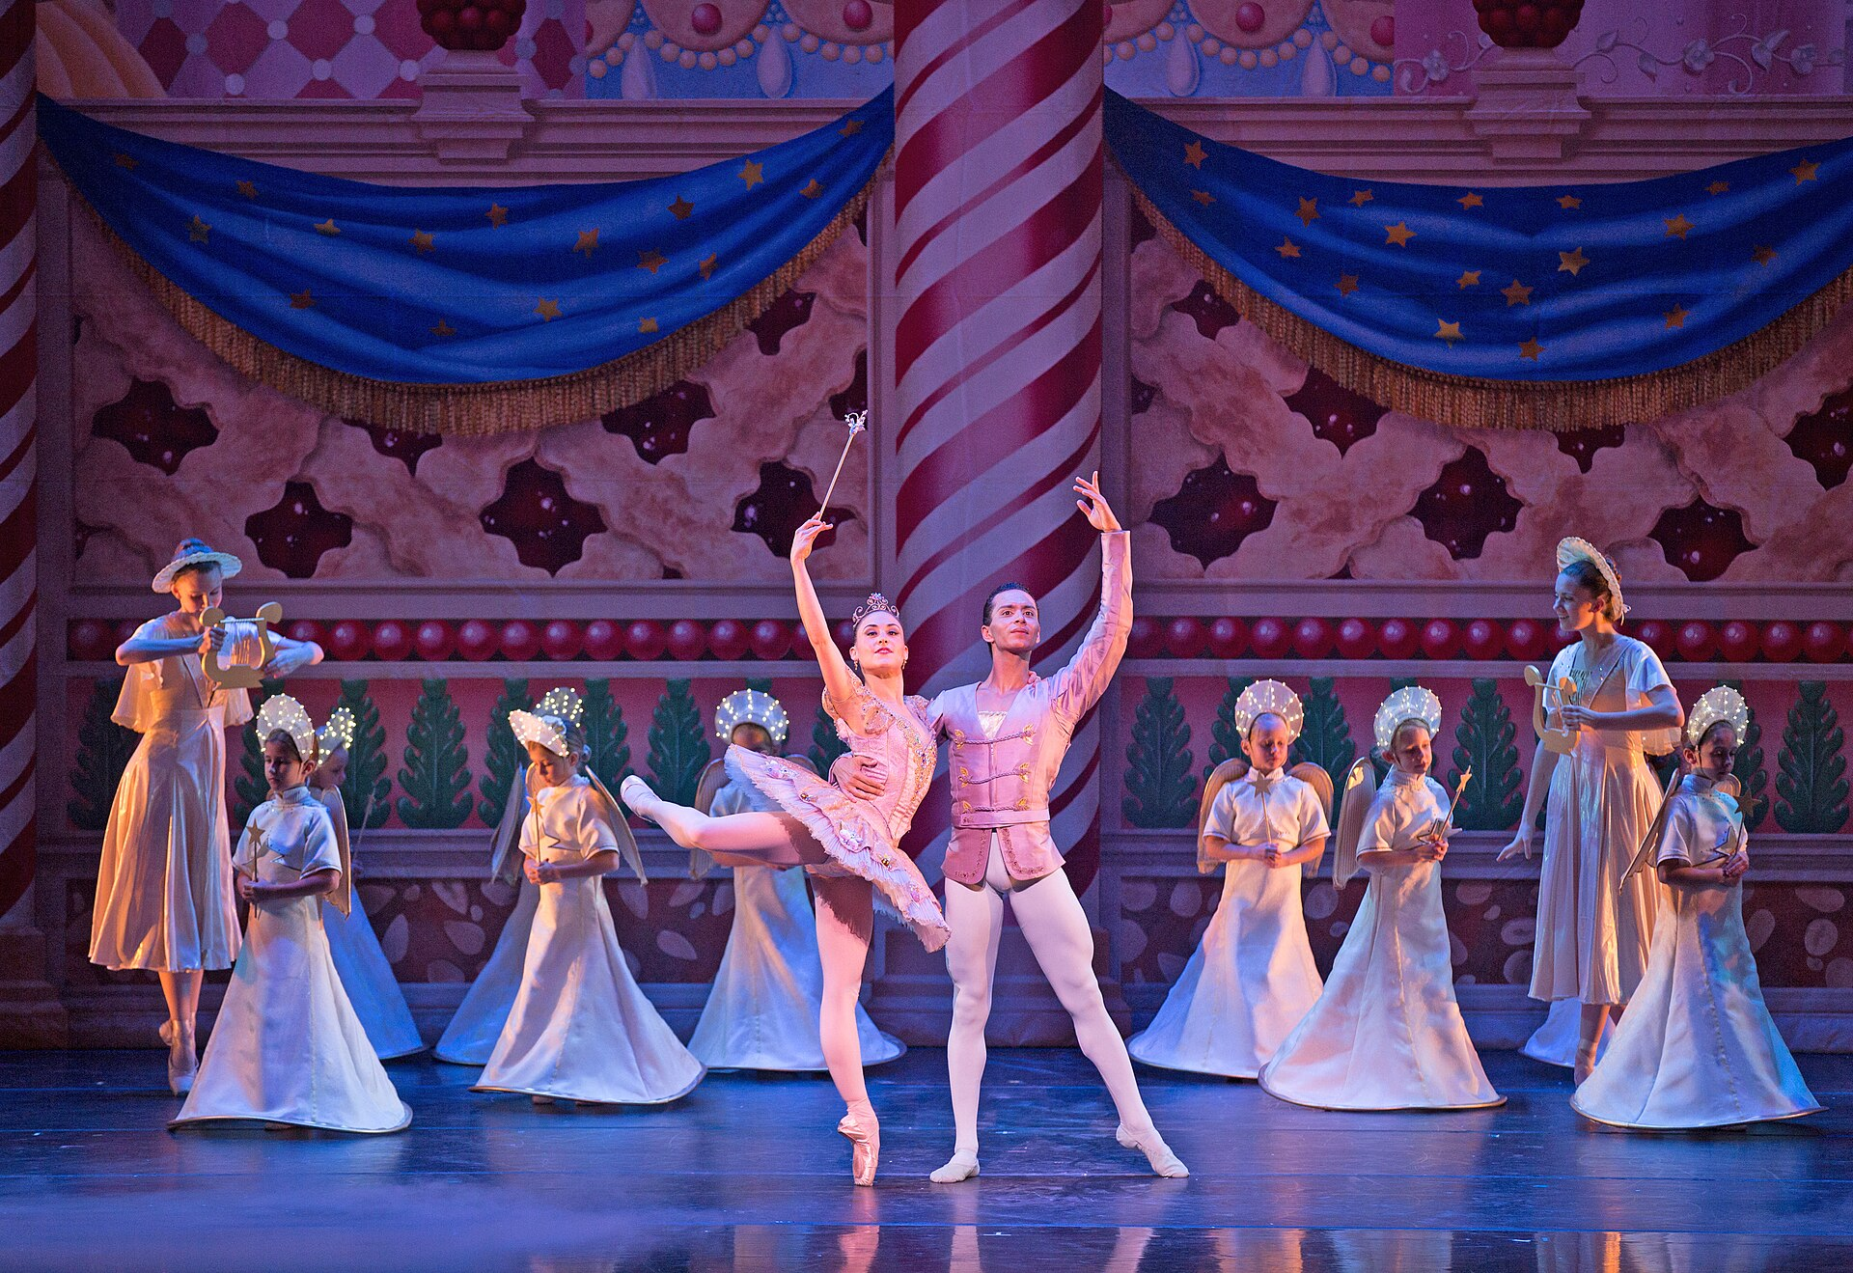
[STUDIO NAME]
MAKE IT A
[DAY]
OUTING
The Nutcracker
[EXACT DATE + TIME]
Tickets through the link in bio
PHOTO EXAMPLE / REPLACE BEFORE POSTING
Notes:
BWC Nutcracker Feed template 6. Full-photo, large-white-type revision inspired by the user's Barre Trash direction. Headline: Arial Black, body: Arial; an editable approximation, not a verified Barre Trash font match. All wording remains editable. Replace the picture through the Selection Pane (the dark contrast overlay and text sit above it). Replace brackets and the Clara description when relevant. Keep faces and the main dancer's movement clear. Remove the PHOTO EXAMPLE label only after replacing the reference photo. Export as PNG. Stories need a real ticket-link sticker added in Instagram. Reference photo: KCB Company Dancers Tempe Ostergren and Lamin Pereira dos Santos
Photography by Rosalie O'Connor; KCBalletMedia; 2015-12-02 20:29; https://commons.wikimedia.org/wiki/File:KC_Ballet_Kansas_City_Ballet_(23410903962).jpg; https://creativecommons.org/licenses/by/2.0. Cropped and resized. Not BWC client work or the fictional studio's production. Matching copy: 13.

Slide 7
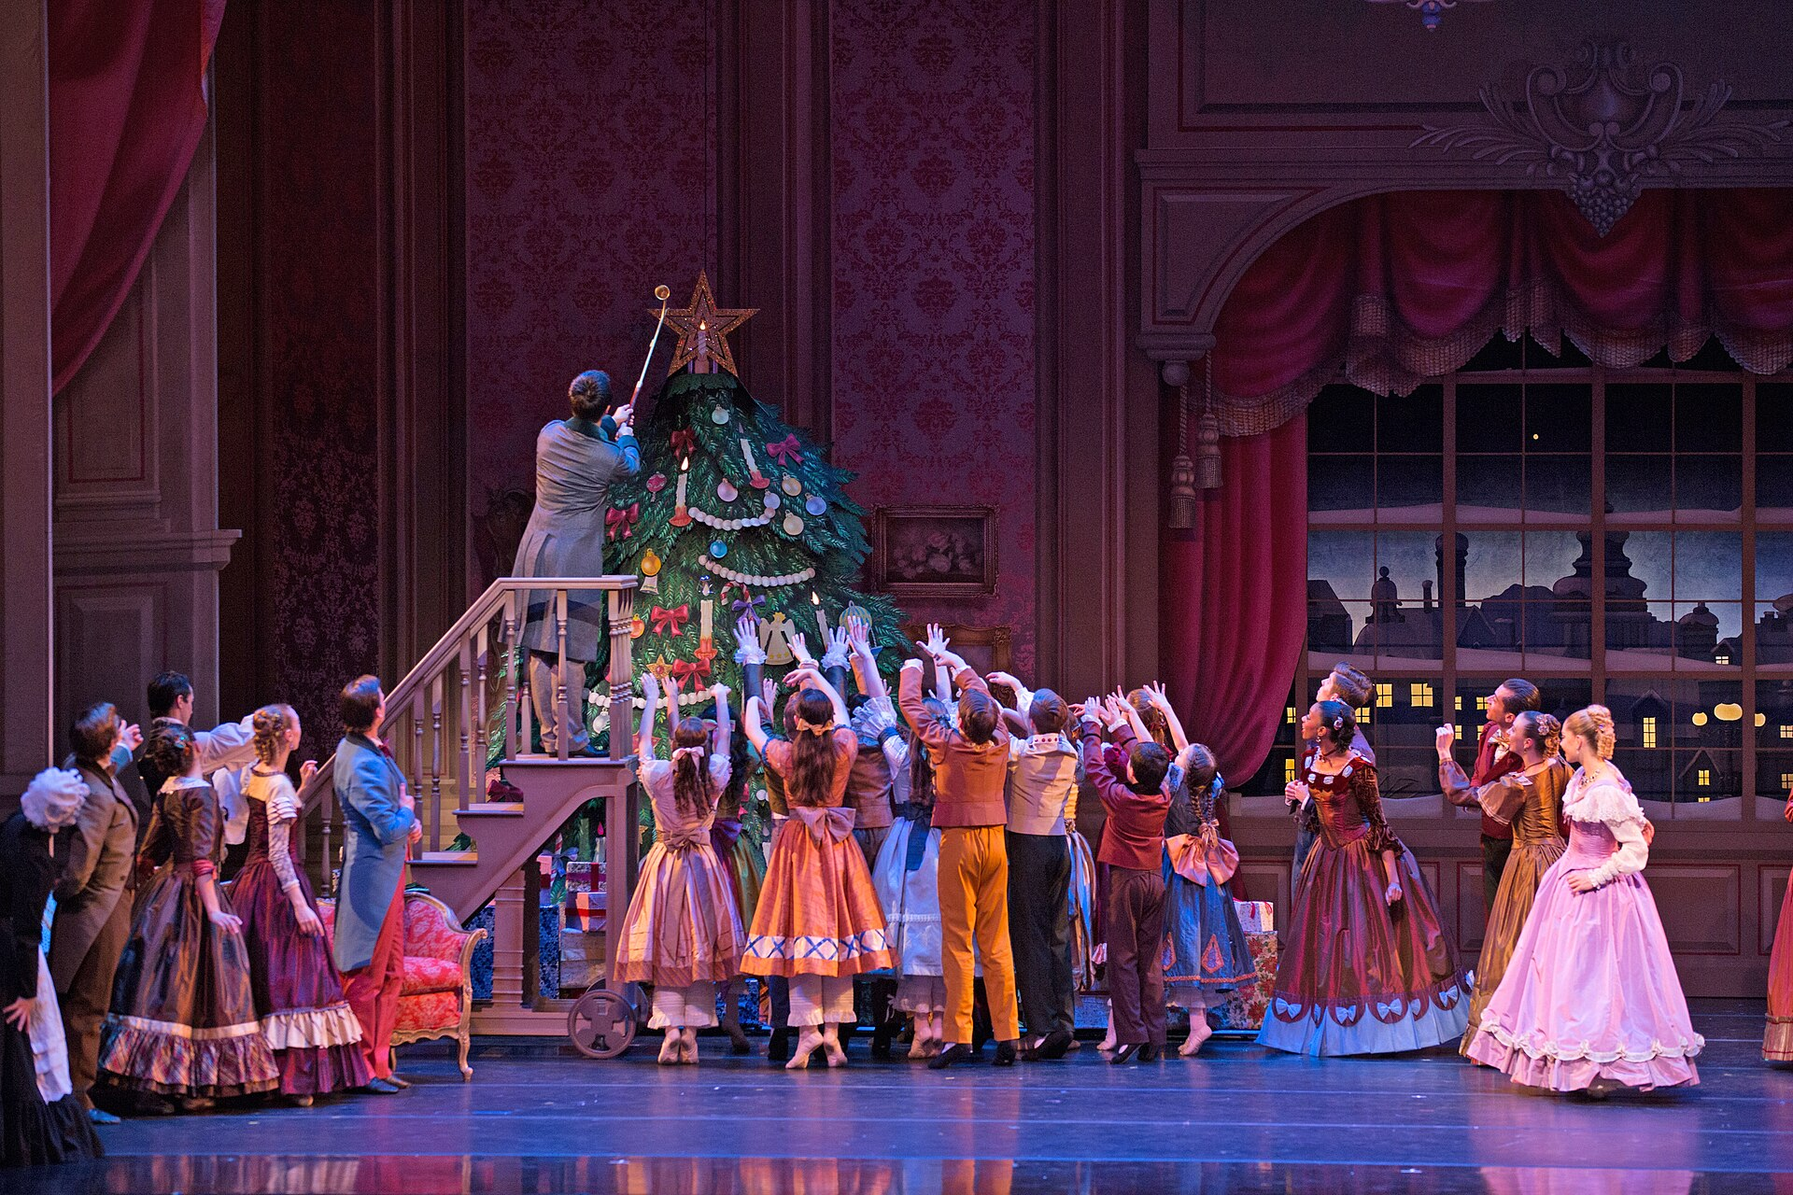
[STUDIO NAME]
BEFORE YOU
LEAVE HOME
ARRIVAL
[ARRIVAL]
PARKING
[PARKING]
ENTRY
[ENTRY]
Full visitor details through our bio
PHOTO EXAMPLE / REPLACE BEFORE POSTING
Notes:
BWC Nutcracker Feed template 7. Full-photo, large-white-type revision inspired by the user's Barre Trash direction. Headline: Arial Black, body: Arial; an editable approximation, not a verified Barre Trash font match. All wording remains editable. Replace the picture through the Selection Pane (the dark contrast overlay and text sit above it). Replace brackets and the Clara description when relevant. Keep faces and the main dancer's movement clear. Remove the PHOTO EXAMPLE label only after replacing the reference photo. Export as PNG. Stories need a real ticket-link sticker added in Instagram. Reference photo: KCB Dancers with KCB School Students
Photography by Rosalie O'Connor; KCBalletMedia; 2015-12-02 19:21; https://commons.wikimedia.org/wiki/File:KC_Ballet_Kansas_City_Ballet_(23436863611).jpg; https://creativecommons.org/licenses/by/2.0. Cropped and resized. Not BWC client work or the fictional studio's production. Matching copy: 17.

Slide 8
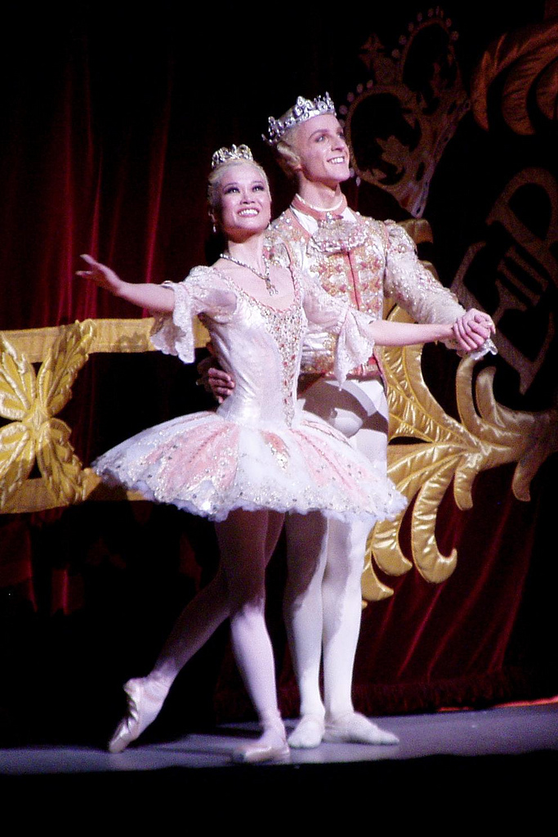
[STUDIO NAME]
YOU WERE
PART OF
THE MAGIC
Thank you, [TOWN]
What moment stayed with you?
PHOTO EXAMPLE / REPLACE BEFORE POSTING
Notes:
BWC Nutcracker Feed template 8. Full-photo, large-white-type revision inspired by the user's Barre Trash direction. Headline: Arial Black, body: Arial; an editable approximation, not a verified Barre Trash font match. All wording remains editable. Replace the picture through the Selection Pane (the dark contrast overlay and text sit above it). Replace brackets and the Clara description when relevant. Keep faces and the main dancer's movement clear. Remove the PHOTO EXAMPLE label only after replacing the reference photo. Export as PNG. Stories need a real ticket-link sticker added in Instagram. Reference photo: Miyako Yoshida and Steven McRae as the Sugar Plum Fairy and her prince in the Royal Ballet production of the Nutcracker on Wednesday 2 December 2009.; scillystuff from UK; 2009-12-02 21:46; https://commons.wikimedia.org/wiki/File:Sugar_Plum_Fairy.jpg; https://creativecommons.org/licenses/by/2.0. Cropped and resized. Not BWC client work or the fictional studio's production. Matching copy: bonus thank-you caption.

