Slide 1
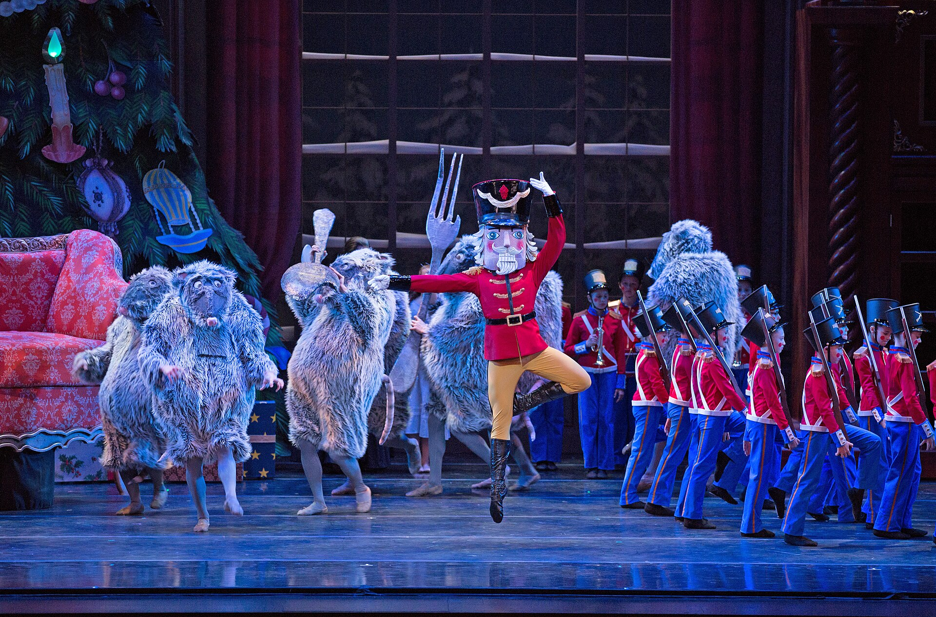
[STUDIO NAME]
YOUR HOLIDAY
OUTING
The Nutcracker
In [TOWN]
PHOTO EXAMPLE / REPLACE BEFORE POSTING
Notes:
BWC Nutcracker Story template 1. Full-photo, large-white-type revision inspired by the user's Barre Trash direction. Headline: Arial Black, body: Arial; an editable approximation, not a verified Barre Trash font match. All wording remains editable. Replace the picture through the Selection Pane (the dark contrast overlay and text sit above it). Replace brackets and the Clara description when relevant. Keep faces and the main dancer's movement clear. Remove the PHOTO EXAMPLE label only after replacing the reference photo. Export as PNG. Stories need a real ticket-link sticker added in Instagram. Reference photo: KCB Company Dancer Charles Martin
Photography by Rosalie O'Connor; KCBalletMedia; 2015-12-02 19:49; https://commons.wikimedia.org/wiki/File:KC_Ballet_Kansas_City_Ballet_(23410876622).jpg; https://creativecommons.org/licenses/by/2.0. Cropped and resized. Not BWC client work or the fictional studio's production. Matching copy: Story collection pages 18–19 and walkthrough page 24.

Slide 2
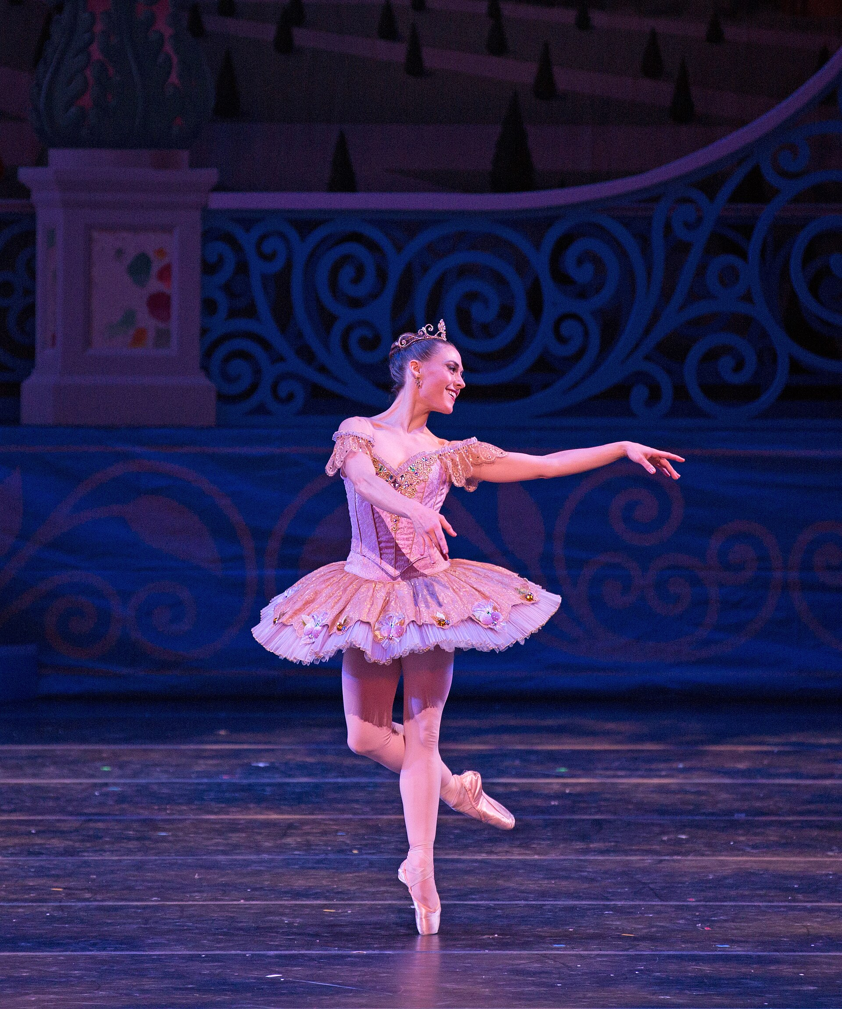
[STUDIO NAME]
THE
NUTCRACKER
[DATES + TIMES]
[VENUE], [TOWN]
PHOTO EXAMPLE / REPLACE BEFORE POSTING
Notes:
BWC Nutcracker Story template 2. Full-photo, large-white-type revision inspired by the user's Barre Trash direction. Headline: Arial Black, body: Arial; an editable approximation, not a verified Barre Trash font match. All wording remains editable. Replace the picture through the Selection Pane (the dark contrast overlay and text sit above it). Replace brackets and the Clara description when relevant. Keep faces and the main dancer's movement clear. Remove the PHOTO EXAMPLE label only after replacing the reference photo. Export as PNG. Stories need a real ticket-link sticker added in Instagram. Reference photo: KCB Company Dancer Tempe Ostergren
Photography by Rosalie O'Connor; KCBalletMedia; 2015-12-02 21:07; https://commons.wikimedia.org/wiki/File:KC_Ballet_Kansas_City_Ballet_(23493180136).jpg; https://creativecommons.org/licenses/by/2.0. Cropped and resized. Not BWC client work or the fictional studio's production. Matching copy: Story collection pages 18–19 and walkthrough page 24.

Slide 3
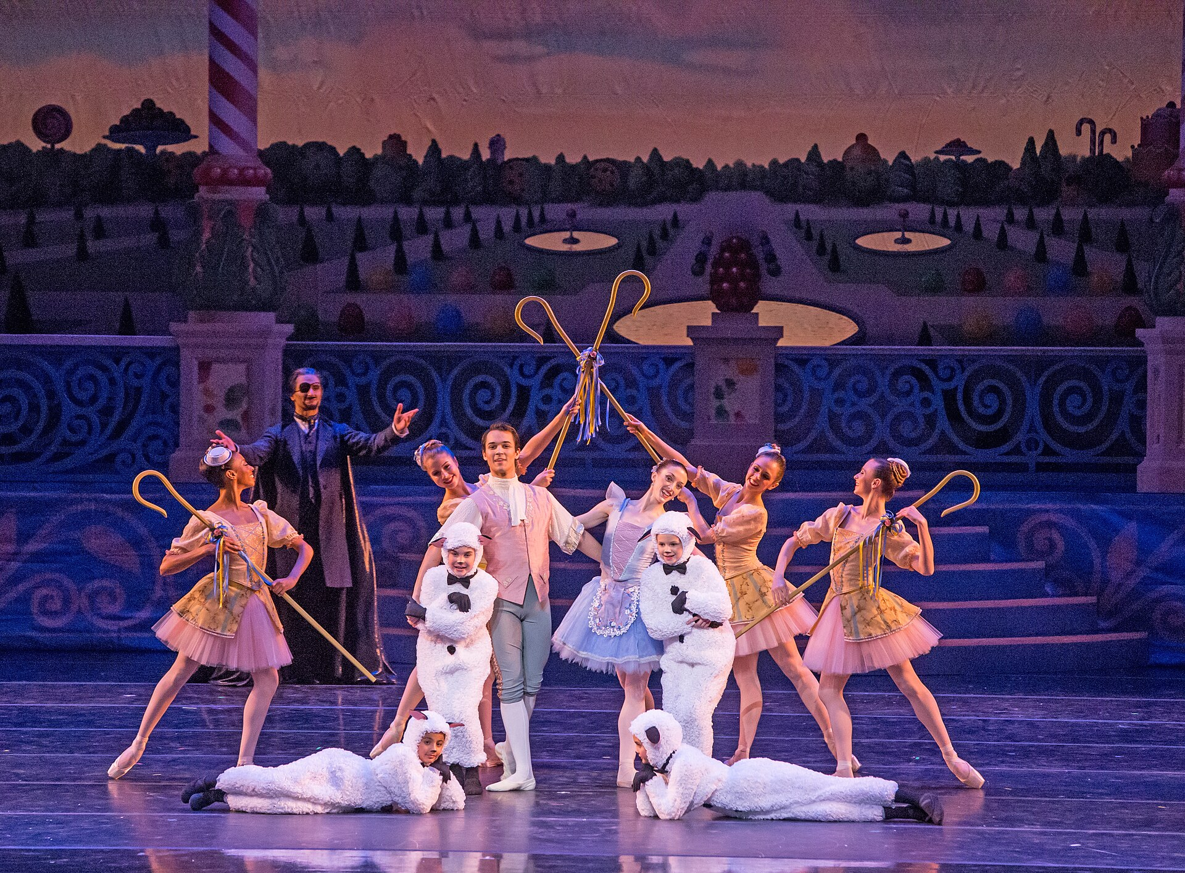
[STUDIO NAME]
CHOOSE
YOUR
PERFORMANCE
[DATES + TIMES]
ADD YOUR TICKET-LINK STICKER HERE
PHOTO EXAMPLE / REPLACE BEFORE POSTING
Notes:
BWC Nutcracker Story template 3. Full-photo, large-white-type revision inspired by the user's Barre Trash direction. Headline: Arial Black, body: Arial; an editable approximation, not a verified Barre Trash font match. All wording remains editable. Replace the picture through the Selection Pane (the dark contrast overlay and text sit above it). Replace brackets and the Clara description when relevant. Keep faces and the main dancer's movement clear. Remove the PHOTO EXAMPLE label only after replacing the reference photo. Export as PNG. Stories need a real ticket-link sticker added in Instagram. Reference photo: KCB Company Dancers
Photographer: Brett Pruitt & East Market Studios; KCBalletMedia; 2015-12-02 19:48; https://commons.wikimedia.org/wiki/File:KC_Ballet_Kansas_City_Ballet_(23520133475).jpg; https://creativecommons.org/licenses/by/2.0. Cropped and resized. Not BWC client work or the fictional studio's production. Matching copy: Story collection pages 18–19 and walkthrough page 24.

